Slide 1
Decision Support Tool
MSCI 100
Team 13
Remi Shah, Tanushree Sharma, Ishu Singh, Andy Su, Jane Tong

Slide 2

Purpose
Promotes efficient time management in team projects
Clear work breakdown
Effective scheduling
Provides complete overview of project
Progress tracking
http://www.rightsourcemarketing.com/marketing-strategy/how-to-build-an-effective-content-marketing-plan/

Slide 3
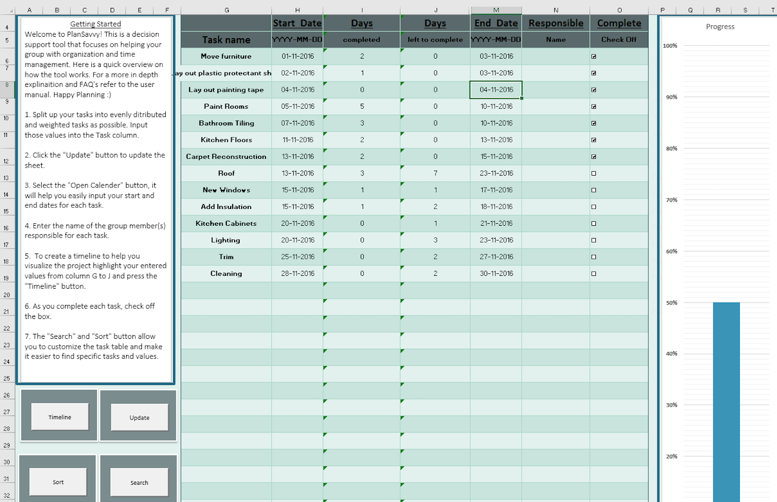
Design Overview
Dashboard
Initial information input
Task name
Start/End Date
Completion Boxes
Completion Bar
Timeline/Gantt Chart

Slide 4
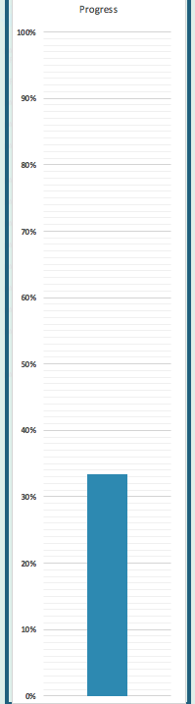
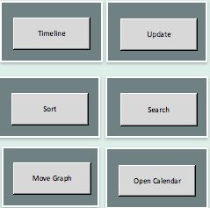
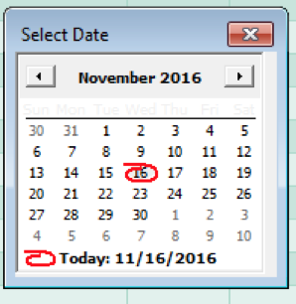
Technical Aspects
VBA
UserForm
Buttons
Graphs
Table
Calendar
Formulas

Slide 5
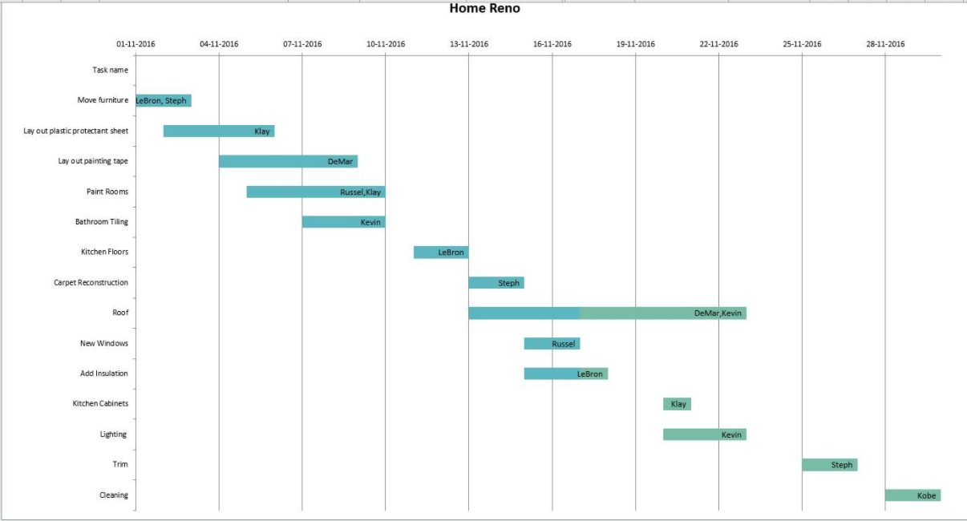
Product
Gantt/Timeline Chart
Use of visual to effectively plan and display the project
Increases level of accountability for each member
Quick access of information

Slide 7
Limitations/Variances
Initially requires considerable user input
Scale of project
Dates
Number of tasks
Scheduling
Initial plan versus outcome

Slide 8
Thanks for listening and have a Ganttastic day!

